Slide 1
Digital Signature, Certificate Authority and Public-Key Infrastructure
Prof. M. Odeo
Lecturer

Slide 2
Digital Signature and Verification
Digital signature is a mechanism by which a message is authenticated i.e. proving that a message is effectively coming from a given sender, much like a signature on a paper
document.

Slide 3
The Need
Social & business activities and their associated documents are becoming digital
  digital conferences
  digital contract signing
  digital cash payment
Hand-written signatures are not applicable to digital data

Slide 4
Digital Signature (based on RSA)
Bob:
  Chooses 2 primes: p=5, q=11
  Multiplies p and q n=p*q =55
  Finds out two numbers e=3 & d=27 which satisfy 3*27=1(mod 40)
  Bob’s public key
    2 numbers: (3,55)
    Encryption algor: modular exponentiation

Slide 5
Digital Signature (based on RSA)
Bob has a document m=19 to sign:
  Uses his secret key d=27 to calculate the digital signature of m=19:
    S = m^{d}(mod n)
    = 19²⁷(mod 55)
    = 24
  Appends 24 to 19. Now (m,s)=(19,24) indicates that the doc is 19, and bob’s signature on the doc is 24.

Slide 6
Digital Signature (based on RSA)
Cathy, a verifier
  Receives a pair (m,s) = (19,24)
  Looks up the phone book and finds out Bob’s public key (e,n) = (3,55)
  Calculates t = s^{e}(mod n)
  = 24³(mod 55)
  = 19
  Check whether t = m
  Confirms that (19,24) is a genuinely signed document of Bob if t = m.

Slide 7
How about long documents
In the previous example, a document has to be an integer in (0, …, n]
To sign a very long document, we need a so called one way hash algorithm.
Instead of signing directly on a doc, we hash the doc first, and sign the hashed data which is normally short.

Slide 8
One-way Hash Algorithm
A one-way hash algorithm hashes an input document into a condensed short output say of 100 bits
  Denoting a one-way hash algorithm by H(.), we have:
    Input : m=a binary string of any length
    Output: H(m)=a binary string of L bits, called the hash of m under H.

Slide 9
One-way Hash Algorithm
The output length parameter L is fixed for a given one-way hash function H.
e.g
The one-way hash function “MD5” has L=128 bits
The one-way hash function “SHA-1” has L=160 bits

Slide 10
Properties of one-way Hash functions
Good one-way hash algorithm H needs to have these properties:
  Easy to evaluate – should be fast
  Hard to reverse – there is no feasible algor to reverse a hashed value
  Hard to find collisions – there is no feasible algor to find two or more input docs which are hashed into the same condensed output

Slide 11
Why Digital Signatures
Unforgeable – takes 1 billion years to forge
Undeniable by the signatory
Universerly verifiable
Differs from doc to doc
Easily implementable by
  Software
  Hardware
  Softwre + hardware

Slide 12
Important digital signatures
RSA – strongly supported by industries
Schnorr digital signature – based on infeasibility of discrete logarithm.
DSS (digital signature standard, USA)
  Based on infeasibility of discrete logarithm.
  Strongly pushed forward by US govt.
Signature scheme using ellipse curves

Slide 13
Hashing – Message Digest
For Digital signature, another technique used is called hashing. Hashing produces a message digest that is a small and unique representation (a bit like a sophisticated checksum) of the complete message.
Hashing algorithms are a one-way encryption, i.e. it is impossible to
derive the message from the digest.

Slide 14
Why message digest?
The main reasons for producing a message digest are:
1 The message integrity being sent is preserved; any message alteration will immediately be detected;
2 The digital signature will be applied to the digest, which is usually considerably smaller than the message itself;
3 Hashing algorithms are much faster than any encryption algorithm (asymmetric or symmetric).

Slide 15
Signature verification
The signature verification includes the following 3 steps:
a) Message digest decryption. The digest has been encrypted using the issuer’s (Alice)
private-key. The digest is now decrypted using the issuer’s public-key included in the message.
b) Digest evaluation. Since hashing is a one- way process i.e. the message cannot be
derived from the digest itself, the recipient must re-evaluate the digest using the
exact same hashing algorithm the issuer used.

Slide 16
Signature verification
c) Digests comparison. The digest decrypted in a) and the digest evaluated in b) are
compared. If there is a match, the signature has been verified, and the recipient can
accept the message as coming unaltered from the issuer.
If there is a mismatch this
could mean that:
i) The message has not been signed by the issuer or
ii) The message has been altered.
  iii) In both cases, the message should be rejected.

Slide 17
Identity and keys
Until now, we have taken for granted the keys being used for encryption/
decryption and digital signature /verification belong to Bob and Alice.
How can we be sure that Alice is really Alice?
And, how can Alice be sure that only Bob will see what she encrypted?

Slide 18
Identity and keys
So far, the only thing we know is that the user of a given key pair has signed and encrypted the message.
But, is he really the owner? George, for instance, may have sent a message to Bob pretending that he is Alice; Bob cannot tell whether or not it is Alice or George who is sending the message.
The same applies to Bob’s public-key. This issue is solved by the use of certificates.

Slide 19
What is a Certificate
A certificate is a piece of information that proves the identity of a public-key’s owner.
Like a passport, a certificate provides recognized proof of a person’s (or entity) identity.

Slide 20
What is a Certificate
Certificates are signed and delivered securely by a trusted third party entity called a Certificate Authority (CA).
As long as Bob and Alice trust this third party, the CA, they can be assured that the keys belong to the persons they claim to be.

Slide 21
Signature verification
A certificate contains among other things:
1) The CA’s identity
2) The owner’s identity
3) The owner’s public-key
4) The certificate expiry date
5) The CA’s signature of that certificate
6) Other information that is beyond the scope of this article.

Slide 22
Signature verification
With a certificate instead of a public-key, a recipient can now verify a few things about the issuer to make sure that the certificate is valid and belongs to the person claiming its
ownership:

Slide 23
Signature verification
With a certificate instead of a public-key, a recipient can now verify a few things about the
1) Compare the owner’s identity
2) Verify that the certificate is still valid
3) Verify that the certificate has been signed by a trusted CA
4) Verify the issuer’s certificate signature, hence making sure it has not been altered.

Slide 24
Signature verification
Bob can now verify Alice’s certificate and be assured that it is Alice’s private-key that has been used to sign the message.
Alice must be careful with her private-key and must not divulge how to get to it; by doing so, she is enforcing one aspect of the non-repudiation feature associated with her digital signature.

Slide 25
Signature verification
There is more to consider for effective non-repudiation support.
Note that certificates are signed by a CA, which means that they cannot be altered.
In turn, the CA signature can be verified using that CA’s certificate.

Slide 26
Certificate validation added to the process
When Alice encrypts a message for Bob, she uses Bob’s certificate.
Prior to using the public-key included in Bob’s certificate, some additional steps are performed to validate Bob’s certificate:
1) Validity period of Bob’s certificate
2) The certificate belongs to Bob
3) Bob’s certificate has not been altered
4) Bob’s certificate has been signed by a trusted CA

Slide 27
Certificate validation added to the process
Additional steps would be required to validate the CA’s certificate in the case where Alice does not trust Bob’s CA.
These steps are identical to the ones requires to validate Bob’s certificate.
In the example below, it is assumed that both Bob and Alice trust that CA.

Slide 28
Example
Alice wants to make sure that the PuKB included in CertB belongs to Bob and is still valid.
She checks the Id field and finds BobId, which is Bob’s identity.
In fact, the only thing she really knows is that this certificate appears to belong to Bob.

Slide 29
Example cont’d
She then checks the validity fields and finds that the current date and time is within the validity period.
So far the certificate seems to belong to Bob and to be valid.
The ultimate verification takes place by verifying CertB’s signature using the CA’s publickey (PuKCA found in CertCA).

Slide 30
Example
If CertB signature is ok, this means that:
a) Bob’s certificate has been signed by the CA in which Alice and Bob have put all their trust.
b) Bob’s certificate integrity is proven and has not been altered in any way.

Slide 31
Example
c) Bob’s identity is assured and the public-key included in the certificate is still valid
and belongs to Bob. Therefore, Alice can encrypt the message and be assured that
only Bob will be able to read it.
Similar steps will be performed by Bob on Alice’s certificate before verifying Alice’s signature.

Slide 32
Public-Key Infrastructure (PKI).
What is a PKI?
A PKI is a combination of software and procedures providing a means for managing keys and certificates, and using them efficiently.

Slide 33
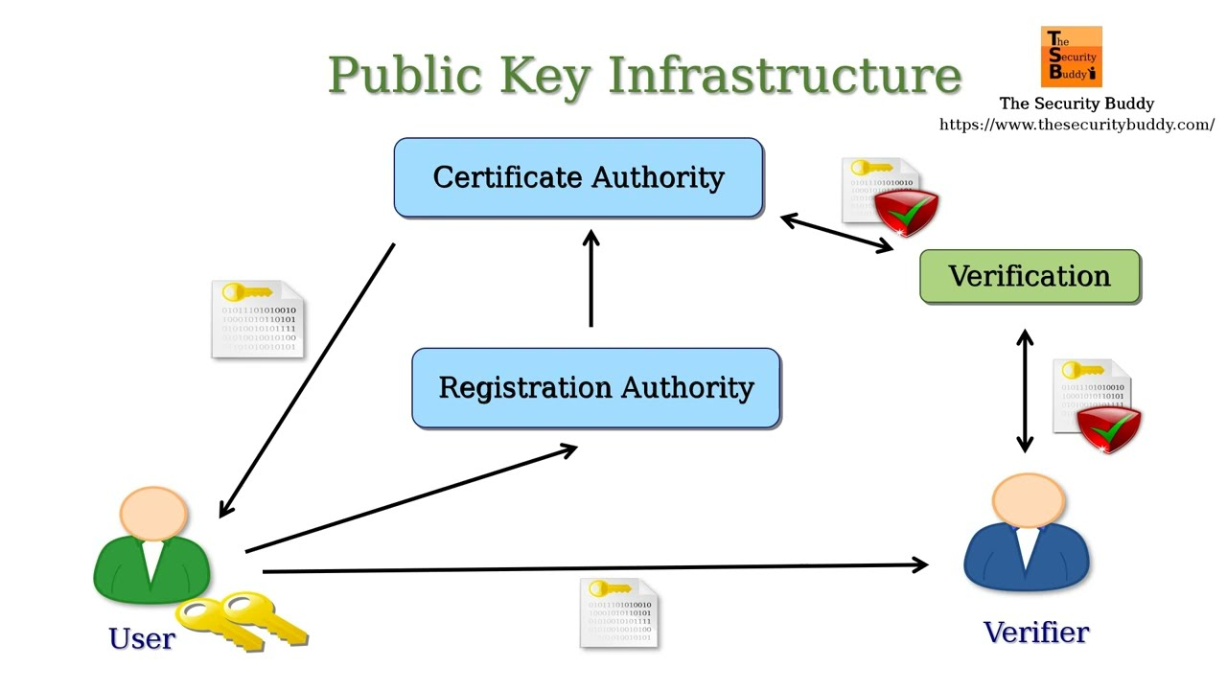
Illustration 1

Slide 34
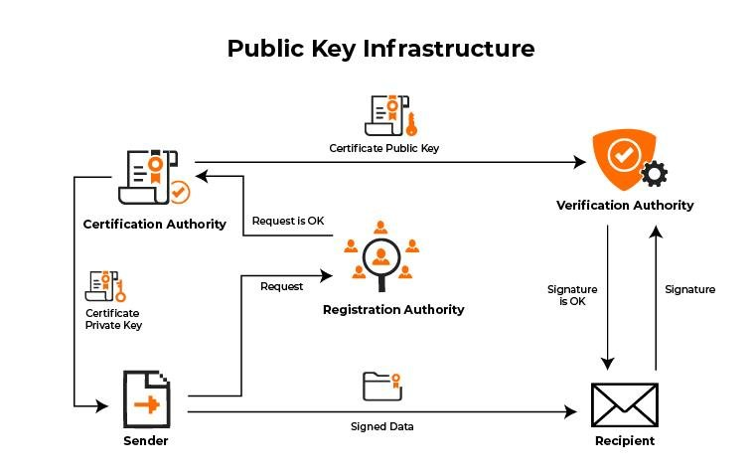
Illustration 2

Slide 35
Key and certificate management
Key and certificate management is the set of operations required to create and maintain keys and certificates.
The following is the list of the major points being addressed in a managed PKI:

Slide 36
Major points - PKI
1) Key and certificate creation: How to generate key pairs? How to issue certificates to the users?
  A PKI must offer software support for key pair generation as well as certificate requests.
  In addition, procedures must be put in place to verify the user identity prior to allowing him to request a certificate.

Slide 37
Major points - PKI
2) Private-key protection: How will the user protect his private-key against misuse by other malicious users?
  Certificates are widely accessible because they are used for either encryption or signature verification.
  Private-keys require some reasonable level of protection because they are used either for decryption or for digital signature.
  A strong password mechanism must be part of the features of an effective PKI.

Slide 38
Major points - PKI
3) Certificate revocation: How to handle the situation where a user’s private-key has been compromised? Similarly, how to handle the situation where an employee leaves the company? How to know whether or not a certificate has been revoked?
  A PKI must provide a means by which a certificate can be revoked. Once revoked, this certificate must be included in a revocation list that is available to all users.
  A mechanism must be provided to verify that revocation list and refuse to use a revoked certificate.

Slide 39
Major points - PKI
4) Key backup and recovery: What happens to encrypted files when a user loses his private-key?
  Without key backup, all messages and files that have been encrypted with his public-key can no longer be decrypted and are lost forever.
  A PKI must offer private-key backup and a
  private-key recovery mechanism such that the user can get back his private-key to be able to get access to his files.

Slide 40
Major points - PKI
5) Key and certificate update: What happens when a certificate reaches or is near its expiry date?
  Keys and certificates have a finite lifetime.
  A PKI must offer a mechanism to at least update the expiry date for that certificate.
  Good practice though is to update the user’s keys and certificates.
  The key and certificate update can be automatic in which case the end user gets notified that his keys have been updated, or can require that the user performs an action during or before his keys and certificates expire.

Slide 41
Major points - PKI
6) Key history management:
  After several key updates, how will a user decide which private key to use to decrypt files?
  Each key update operation generates new key pairs. Files that have been encrypted with previous public-keys can only be decrypted with their associated private-keys.
  Without key history management, the user would have to make decision on the key to use for
  decrypting files.

